Slide 1
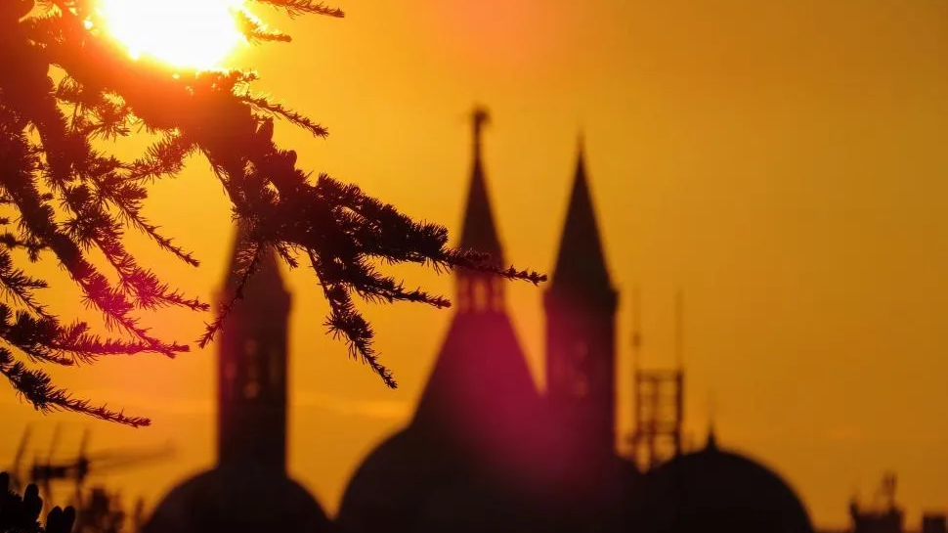

BUSHY POND BAPTIST CHURCH
BP Vision
Five Dollars, One Vision
A year-long faith journey to strengthen our church
and prepare for what God has next.
2026

Slide 2
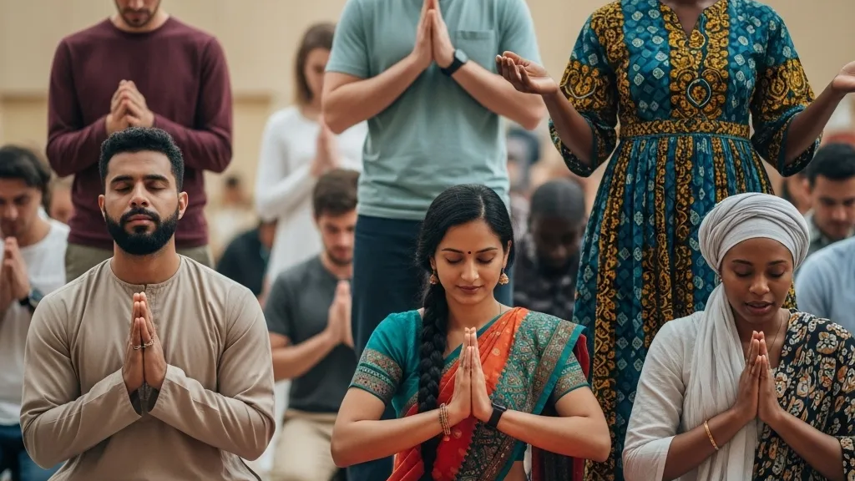

BP Vision 2026
"Saints of God,
this is our moment!"
God is moving at Bushy Pond.
Let us step forward together in faith, unity, and consistency.
Small, faithful steps—multiplied by God.

Slide 3



BP VISION 2026
The Vision:
Preparing for Tomorrow
God has given Bushy Pond a vision not just for today, but for tomorrow. We are moving forward with prayerful planning and joyful obedience.
Growing Ministries
Deepening our discipleship and expanding our reach to impact more lives with the Gospel.
Expanding Outreach
Extending our hands to serve our community and care for our church family in tangible ways.
2026
Faithful Preparation
Building a strong foundation today for what God is calling us to do next.

Slide 4




CAMPAIGN FOUNDATION
Introducing BP Vision 2026
Building our future together on three unshakeable pillars.
Unity
Faith
Consistency
Everyone moving together toward one God-given future. We are stronger when we stand as one body.
Trusting God to multiply what we faithfully give. We believe He will do more than we can ask or imagine.
Small weekly steps that build lasting impact. Faithfulness in the little things leads to great blessings.

Slide 5




TWO WAYS TO GIVE
The Commitment
Weekly Rhythm
One-Time Gift
5
260
$
$
.00
OR
per week
for the year
52 Weeks of Faith
Full Year Vision
Choose the rhythm that helps you be faithful.
"Let each one give as he has decided in his heart."

Slide 6







THE POWER OF MULTIPLICATION
Small Gifts, Big Impact
Your Weekly Gift
Consistency
Your Annual Impact
$5.00
52 Weeks
$260
Imagine the Possibilities
$26,000
When we come together, our individual faithfulness multiplies. If just 100 members commit to this vision, look at what God can do through us in one year.
Total Ministry Fuel

Slide 7




BP VISION 2026
Everyone Doing Their Part
Five dollars a week. Everyone doing their part. One vision for the future of Bushy Pond. When we stand together, we can achieve the impossible.
No Gift Too Small
When given in faith and obedience, even the smallest seed can grow into a mighty harvest.
Power of Unity
We are not asked to carry the load alone, but to lift together as one unified body of believers.
Unity
God Multiplies
When we take small, faithful steps forward, God multiplies the outcome for His glory.

Slide 8




Strengthen Our Ministry
Investing in the spiritual growth of our congregation through vibrant discipleship, impactful worship, and raising up the next generation.
PURPOSE & IMPACT
Why It
Matters
DISCIPLESHIP
NEXT GEN
WORSHIP
Sustain Our Church
Ensuring our facilities are welcoming, our operations are efficient, and we have the resources to care for our church family in times of need.
Your faithful giving directly fuels the mission and future of Bushy Pond Baptist Church.
OPERATIONS
FACILITIES
MEMBER CARE
"For where your treasure is, there your heart will be also."
Prepare for the Future
Building a strong financial foundation that allows us to say "Yes" to wherever God calls us next, without hesitation or delay.
— Matthew 6:21
VISION
EXPANSION
READINESS

Slide 9






1
Pray
YOUR NEXT STEPS
Ask God to lead your heart and your commitment.
How to
Participate
Commit
2
Decide on $5/week or a $260 one-time gift for 2026.
3
Give
Join us on this journey of faith. Every step we take together brings us closer to the vision God has for Bushy Pond.
Set up recurring giving online or use weekly envelopes.
4
Encourage
Invite others in our church family to join the vision.
5
Celebrate
Give consistently, cheerfully, and with vision!

Slide 10


BUSHY POND BAPTIST CHURCH
Five Dollars. One Vision.
A Stronger Bushy Pond for 2026.
Faithful. United. Consistent.
Thank you for giving cheerfully and with vision.
2026

Slide 11
BUSHY POND BAPTIST CHURCH

